Slide 1

Improving Diagnosis and Appropriate Treatment of Urinary Tract Infection:
The National Perspective
Carolyn Gould, MD, MSCR
Division of Healthcare Quality Promotion
Centers for Disease Control and Prevention
MA Infection Prevention Partnership
UTI in the Elderly Workshop
June 18, 2013
National Center for Emerging and Zoonotic Infectious Diseases
Division of Healthcare Quality Promotion

Slide 2
Nothing to disclose

Slide 3
Outline
Diagnostic challenges with UTI in the elderly
Impacts of antimicrobial use
Improving UTI diagnosis and appropriate treatment

Slide 4
UTI in the Elderly: Diagnostic Dilemma
”UTI” incorrectly diagnosed in ~ 40% of cases among patients ≥ 75 years¹
Atypical presentation of disease in this age group
Result is a large amount of inappropriate antimicrobial use
1. Woodford, H. J. & George, J. J Am Geriatr Soc 57:107–114, 2009
Notes:
4

Slide 5
Diagnosing UTI in long-term care facility residents
Multiple comorbid illnesses
    Symptoms may be mistakenly attributed to UTI
Cognitive impairment
  May not be able to report their symptoms
Notes:
5

Slide 6
Asymptomatic bacteriuria
Definition
  Quantitative culture with ≥10⁵ colony forming units/ml in an appropriately collected urine specimen without clinical signs/symptoms localizing to the urinary tract
Incidence of bacteriuria with indwelling urinary catheters
  3-10% per catheter-day
  26% of people with a catheter between 2-10 days
  100% of people with long-term (>30 d) catheters
Bacteriuria is rarely symptomatic

Slide 7
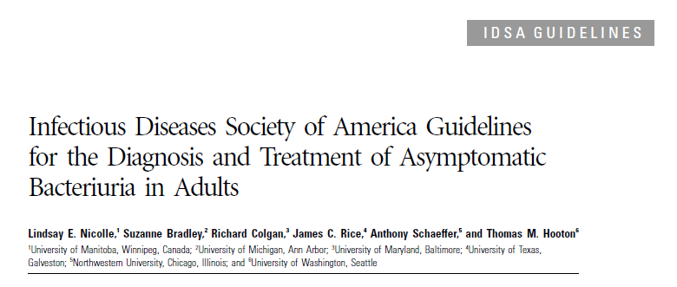
Asymptomatic Bacteriuria (ASB)
Notes:
Recall at the beginning of this presentation we started by defining bacteriuria and classfying it into two groups – this guideline addresses asymptomatic bacteriuria

Slide 8
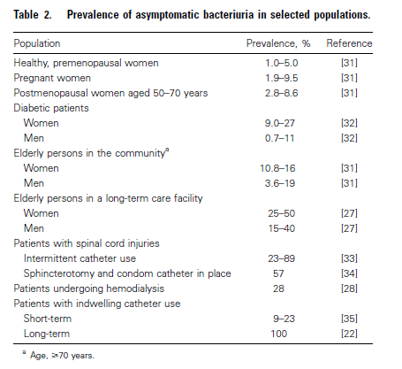
Prevalence of Asymptomatic Bacteriuria
IDSA Guideline: Nicolle LE et al. Clin Infect Dis 2005; 40:643–54

Slide 9

The Iceberg Effect
Infected
Colonized

Slide 10
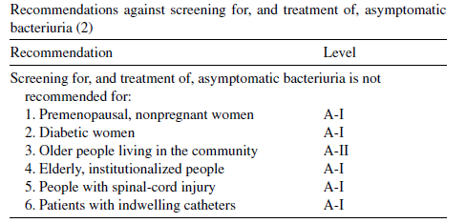
ASB: DON’T screen/ treat
Nicolle, LE Int J Antimicrob Agents. 2006; 28S:S42-S48

Slide 11
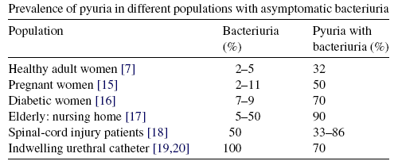
Pyuria and asymptomatic bacteriuria
Pyuria accompanying bacteriuria is NOT an indication for antimicrobial treatment
Nicolle LE. Int J Antimicrob Agents 2006;28S:S42-8

Slide 12
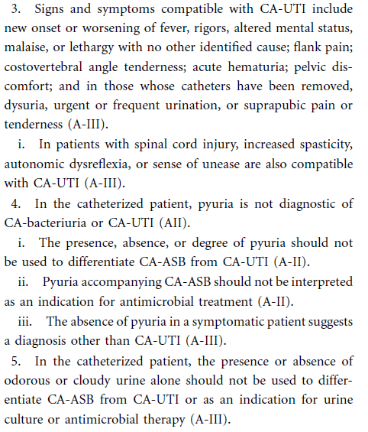
Is pyuria diagnostic?
Hooton TM. Clin Infect Dis 2010;50

Slide 13
Inappropriate treatment of catheter-associated ASB
32% of CA-ASB episodes identified at one center over 3 months were treated inappropriately with antibiotics
Independent risk factors for inappropriate treatment of ASB:
  Older age
  Gram-negative organisms
  Higher urine WBC
Three patients developed C. difficile infection shortly after treatment for ASB
Cope M. Clin Infect Dis 2009;48:1182-8

Slide 14
When is it recommended to screen for and treat ASB?
In pregnant women
Before transurethral resection of the prostate and other urologic procedures where mucosal bleeding is anticipated
Nicolle LE et al. Clin Infect Dis 2005; 40:643–54

Slide 15
No benefit of treating ASB in long-term catheterized patients
Randomized, controlled trial of cephalexin use in long-term catheterized patients with (susceptible) ASB over 12-44 weeks
No differences in:
  Weekly prevalence of bacteriuria (>98% in both groups)
  Number of bacterial strains present
  Febrile days
  Catheter obstruction
75% of bacteria in control group remained susceptible to cephalexin, compared to 36% in treatment group
Warren JW. JAMA 1982;248:454-8

Slide 16
Risks of antimicrobial use for ASB
Selection for antimicrobial resistant pathogens
Adverse reactions to antimicrobials
C. difficile infection

Slide 17
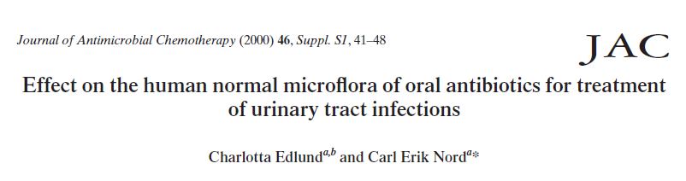
“When antimicrobial agents are prescribed for the treatment of UTIs, not only the antimicrobial spectrum of the agent but also the potential ecological disturbances, including the risk of emergence of resistant strains, should be considered.”

Slide 18
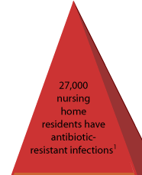


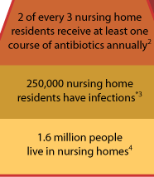

Antimicrobial use in NHs
Antimicrobials are the most frequently prescribed drug class
  Comprise 40% of all prescriptions
  50-70% of residents will receive an antimicrobial during the year
25-75% of antimicrobial use may be inappropriate
http://www.cdc.gov/DRUGRESISTANCE/healthcare/ltc.htm
Nicolle LE et al. ICHE 2000; 21:537-545

Slide 19
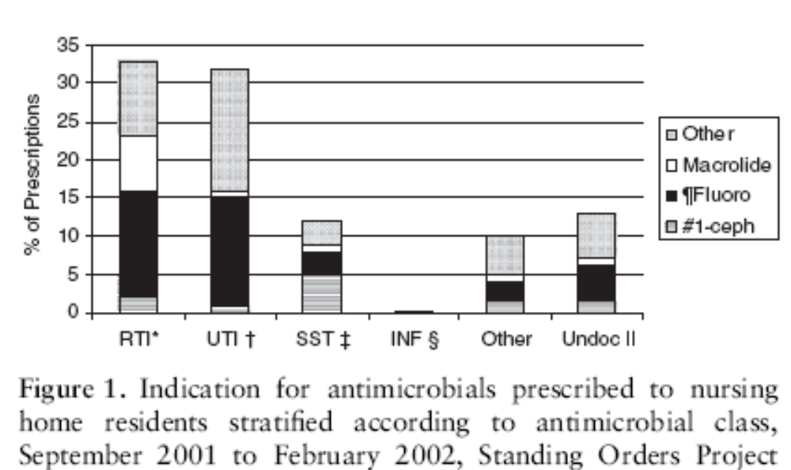
“UTIs” drive antibiotic use in nursing homes
73 LTCF followed over 6 months
42% of residents received antibiotic (3, 392 prescriptions)
Benoit S. et al. JAGS 2008; 56:2039-44
Notes:
And that whole discussion was really a preamble to our next section of the presentation, antibiotic stewardship. UTI is among the most frequently diagnosed conditions for older adults in acute care hospital EDs and a large driver of antibiotic exposure.

Slide 20

Antibiotics are misused in a variety of ways
Given when they are not needed
Continued when they are no longer necessary
Given at the wrong dose
Broad spectrum agents are used to treat very susceptible bacteria
The wrong antibiotic is given to treat an infection
http://www.cdc.gov/getsmart/healthcare/inpatient-stewardship.html#Facts

Slide 21
Antibiotic-Related Adverse Events
Antibiotics account for nearly 1 in 5 (19.3%) drug-related adverse events
  >140,000 ER visits/year due to adverse effect of antibiotics
  Admission required for 6.1% of adverse events
Side Effects: Fluoroquinolones (an example)
  Increased INR
  QT interval prolongation
  Tendon rupture
  Risk of hypo- and hyperglycemia
Shehab et al. Clin Infect Dis. 2008;47:735

Slide 22
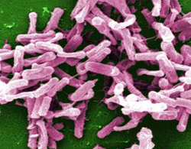
Clostridium difficile Infection (CDI)
Antibiotic exposure is the single most important risk factor
Exposure to antibiotics increases the risk of CDI by at least 3 fold for at least a month¹
Up to 85% of patients with CDI have antibiotic exposure in the 28 days before infection²
1. Stevens et al. Clin Infect Dis. 2011 Jul 1;53(1):42-8
2. Chang HT et al. Infect Control Hosp Epidemiol 2007; 28:926–931

Slide 23
Antibiotics in Patients with CDI
Receipt of non-CDI antibiotics during or soon after CDI therapy is associated with:
  Lower cure rates
  Prolonged diarrhea
  Recurrent CDI
Clin Infect Dis 2011;53:440

Slide 24
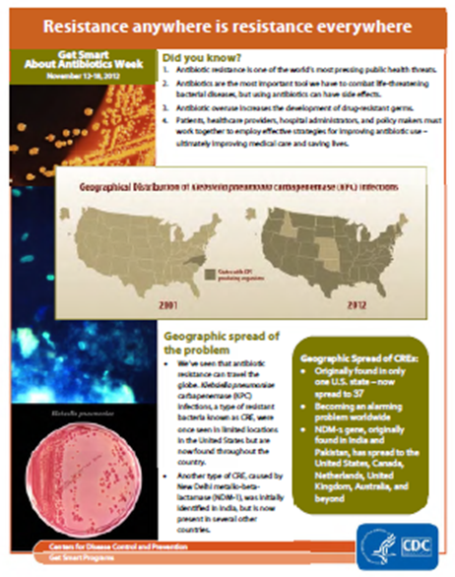

Antibiotic resistance is among CDC's top concerns
“Imminent crisis in the control of infectious diseases”
  IOM report, 2003 Microbial Threats to Health: Emergence, Detection, and Response
“…One of the world's most pressing public health problems”
  Joint Statement on Antibiotic Resistance from 25 National Health Organizations and the CDC, 2012
http://www.cdc.gov/getsmart/
Notes:
The problem is of global concern and is creating dilemmas for the treatment of infections in both hospitals and community health care settings. Moreover, as noted above, the pharmaceutical industry is developing fewer new antimicrobials than in previous years. Therefore, immediate action must be taken to preserve the effectiveness of available drugs by reducing the inappropriate use of antimicrobials in human and animal medicine.

Slide 25
Correlation of antibiotic use and resistance
r = 0.41, p = .004
(Pearson correlation coefficient)
2002-03 (45 long-term acute care hospitals)
Gould et al. ICHE 2006;27:923-5
.
Notes:
Annual prevalence of imipenem resistance in P. aeruginosa vs. carbapenem use rate

Slide 26
Why Aren’t We Doing Better?
Many prescribers are scared of what might happen if they don’t give antibiotics.
Antibiotics are the most common “just in case” drugs.
General perception that there is (almost) no risk and (almost) all benefit to giving an antibiotic.

Slide 27
Why Does This Matter to Patients?
We’re fast running out of antibiotics.
The “post antibiotic era” is already here
  We are already encountering infections for which we have no viable antibiotic treatments.
We’re not getting new antibiotics anytime soon.

Slide 28
Declining : New Antimicrobials to the Market in US
Spellberg B, et al CID 2004; 38:1279-86

Slide 29
Strategies to reduce treatment of ASB
Reduce inappropriate catheter use
Reduce inappropriate orders for urine cultures
  Avoid reflex orders for UA/Ucx for “soft” indications (e.g., falls)
  If you look you will find (and treat)!
    Difficult for clinicians to ignore a positive culture, regardless of symptoms
    Pressure to treat – from patients, families, even surveyors (anecdotal reports from LTC)
Reduce contamination/colonization
  If CAUTI suspected, remove/replace catheter prior to culture
Doernberg SB, V Dudas, KK Trivedi, ID Week 2012, Poster presentation
Hooton TM. Clin Infect Dis 2010;50

Slide 30
Downstream effects of urinary catheters
Secondary BSI
CAUTI
Bacteriuria
Immobilization
Urethral Trauma
Antimicrobials
Urinary Catheter
Pressure Ulcers
Microbiome Disruption
MDRO colonization
Increased LOS
C. difficile infection
MDRO infection
MDRO transmission

Slide 31
Improving the diagnosis of UTI in LTC residents
Surveillance, diagnosis, and treatment recommendations for NH residents developed by ID expert consensus panels
    Updated McGeer criteria for surveillance¹
    IDSA clinical practice guidelines for assessing fever and infection in LTCF residents²
    Loeb minimum criteria for antibiotic use³
Stone et al. ICHE 2012;33:965-77
High et al. Clin Infect Dis 2009;48:149-71
Loeb et al. ICHE 2001;22:120-4
Notes:
31
So, what guidance is available for differentiating clinically important, symptomatic bacteriuria?

Slide 32
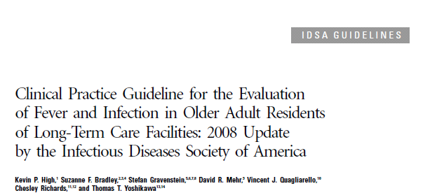
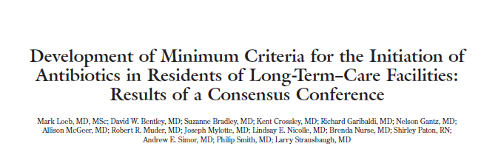
Guidelines for infection diagnosis and management in LTCF
Clin Infect Dis 2009; 48:149-171
Infect Control Hosp Epidemiol 2001; 22:120-124

Slide 33
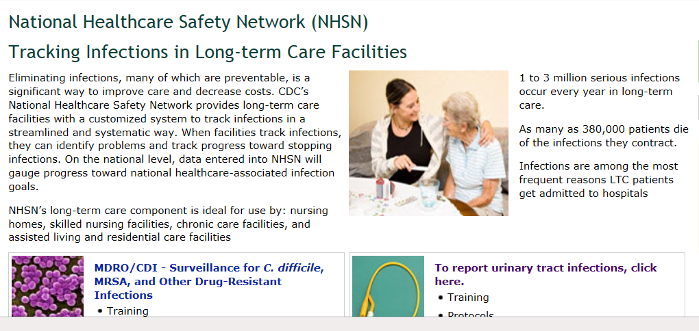
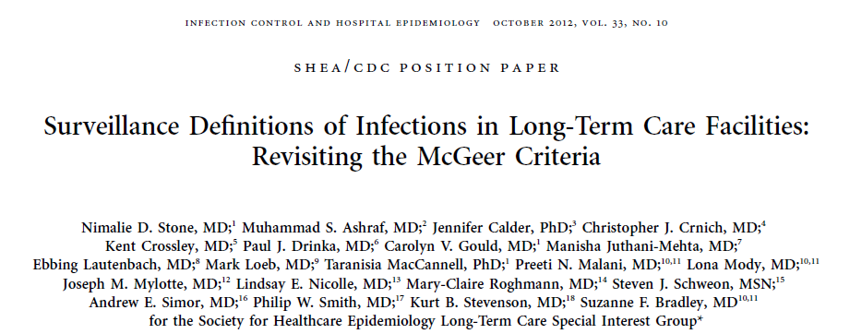
Revised surveillance definitions for LTC
http://www.cdc.gov/nhsn/LTC/index.html

Slide 34
How Can We Get There?
One key 1st step is to identify concrete steps that people can take to improve antibiotic use.
Not “create a stewardship program”
But “implement a specific intervention”

Slide 35
CDC/IHI Antibiotic Driver Diagram
CDC partnered with experts in stewardship and with the Institute for Healthcare Improvement to develop a “Driver Diagram and Change Package” for antibiotic use in hospitals.

Slide 36
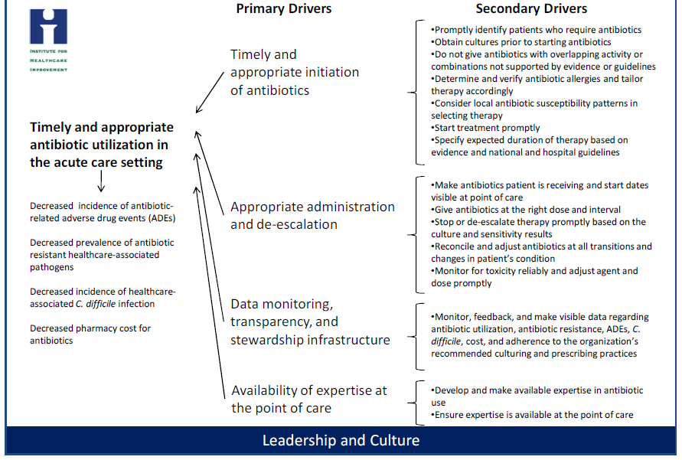
Antibiotic Stewardship Driver Diagram
http://www.cdc.gov/getsmart/healthcare/

Slide 37
Driver Diagram
Improvement Activity A
Improvement Activity B
Improvement Activity C
Improvement Activity D
GOAL
Underlying
Factors
Primary Drivers
Secondary Drivers
Change Ideas

Slide 38
Driver Diagram
A way to visualize an improvement effort
  Connects specific interventions and activities to a larger goal
  Outlines specific changes that can result in improvement
Notes:
A conceptual model for health care organizations identify improvement strategies and processes

Slide 39
Summary
Screening for and treatment of ASB not indicated in most patients/residents
Presence of pyuria not diagnostic of CAUTI
  Absence of pyuria can be useful for ruling out CAUTI
Inappropriate treatment of ASB can lead to C. difficile infection, selection of antimicrobial resistant pathogens, and adverse drug events

Slide 40
Thank you!
Questions?
National Center for Emerging and Zoonotic Infectious Diseases
Place Descriptor Here

